Slide 1
Version Control Using Git and GitHub
The why, what and how

Slide 2
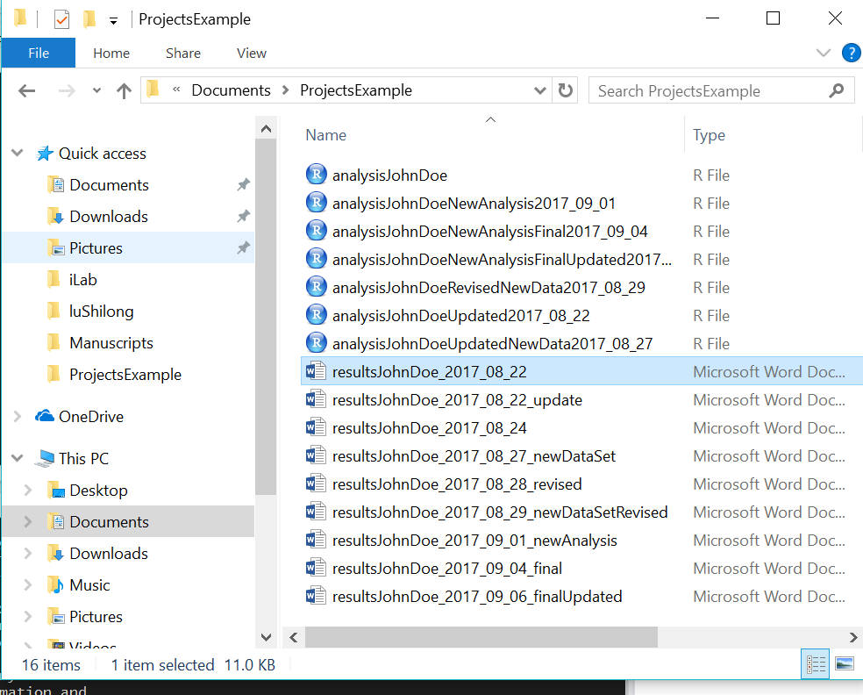
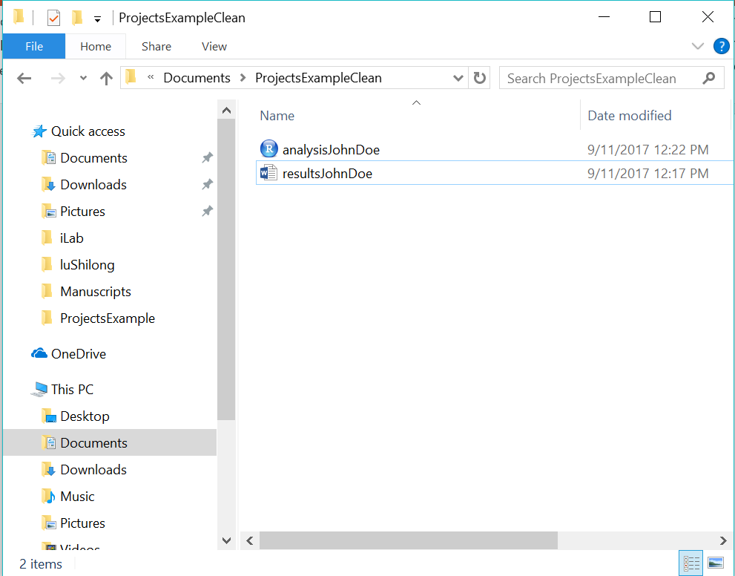
Why – Version Control
Before
After

Slide 3
What - Version Control
Ability to revert a file (e.g., document, R script, or SAS script) to any previous state
Git version control software initially created for web and software development
Reproducible research has increased its use among the scientific community
Beneficial for personal and collaborative work
Simultaneously work on the same document or code
Each version update is accompanied with a “commit” message. This eliminates the need for saving documents such as XXXXXX_2017_09_11_DS…

Slide 4
Git vs. GitHub
Git
GitHub
A type of subversion version control software (VCS)
Aim: Provide local (local machine or network) SVN
Others include
Mercurial
SVK
Fossil
A web-based hosting service for Git
Aim: Allow collaboration and or backup for Git projects
Others include
Bitbucket
Gitlab

Slide 5
Steps
Install Git
https://git-scm.com/
Create a GitHub account
https://github.com/
Create a “local” Git repository
Push the repository to your GitHub account

Slide 6
Jargon
Repository (“repo”) - A project specific folder to be version controlled. Subfolders can be contained within the main project folder.
Staging environment - Where modified files and new files can be added.
Add
Set-up a file in the staging environment to be committed
Commit
Setting up one or more files in the staging environment to have their versions pushed to be the most recent version.
A commit message can be added to provide details on what changes are contained in the files.
Push
Adding changes to Git that were a part of the commit.
Multiple commits can be pushed at once.
Pull
Check the repository for any changes that may have been made and have your local copy updated.
Important for collaborative work. Not as important for individual work unless working on multiple machines.

Slide 7
Jargon cont.
Master - The primary version.
Branch - A separate version from the master that is specific to you. Used for testing out new functionally without changing the master (e.g. stable) version. More applicable for software development and collaborative work.
Reverting - Going back to a previous version based on a specific commit.
Clone - Copying an existing repository and all of its existing version information.
A good glossary of other Git terms

Slide 8
Workflow
Initial Repo Creation
Existing GitHub repository
Create repo on GitHub
Clone repo on local machine
Add stuff to the repo
Commit the new or updated files (stores changes locally)
Push to information to GitHub
Pull repo for latest changes
Modify existing files
Commit changes (stores changes locally)
Push changes to GitHub

Slide 9
Best Practices
Pull
Before making any changes to files, pull to obtain the most recent version.
Commit
Commit often.
Commit message should be detailed to provide others a brief overview of the changes.
ReadMe
Include a ReadMe.txt file in the initial repo folder detailing its purpose.
Include ReadMe.txt files in each subfolder that details its contents.

Slide 10
How - Working with Git and GitHub
Main interfaces
Terminal/cmd prompt
R studio
GitKraken

Slide 11
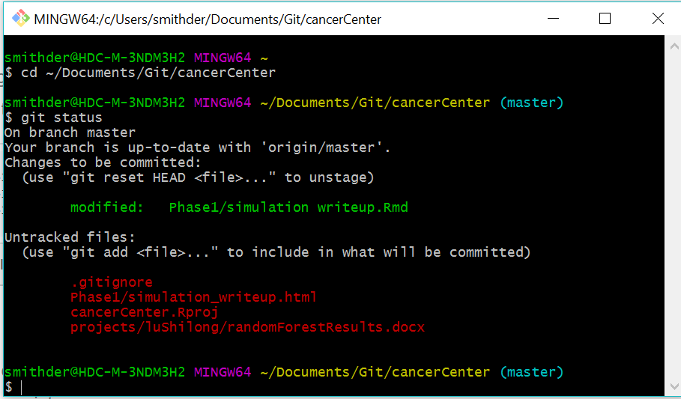
How - Terminal
Example of standard commands:
git status
git add
git commit –m “….”
git pull
git push
git branch
A good Cheat Sheet for commands.

Slide 12
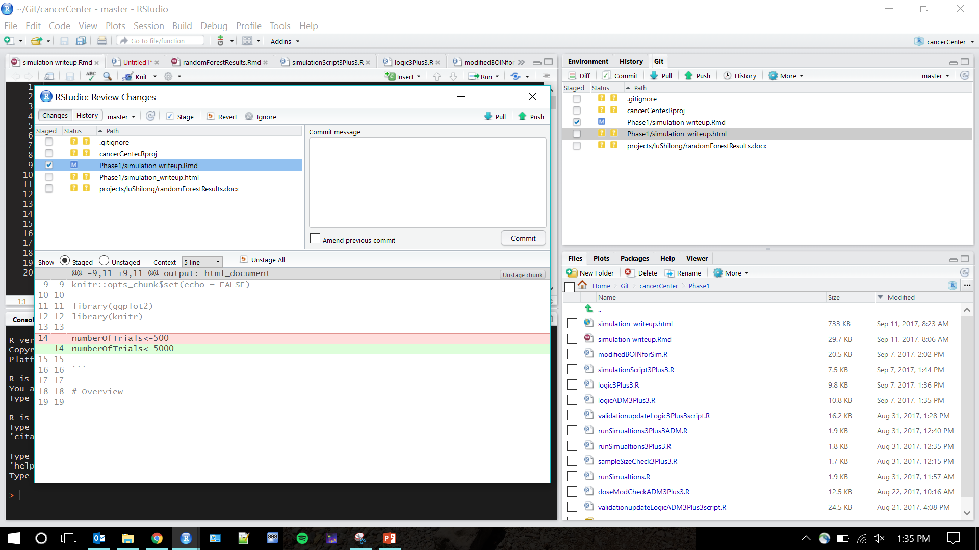
How - RStudio

Slide 13
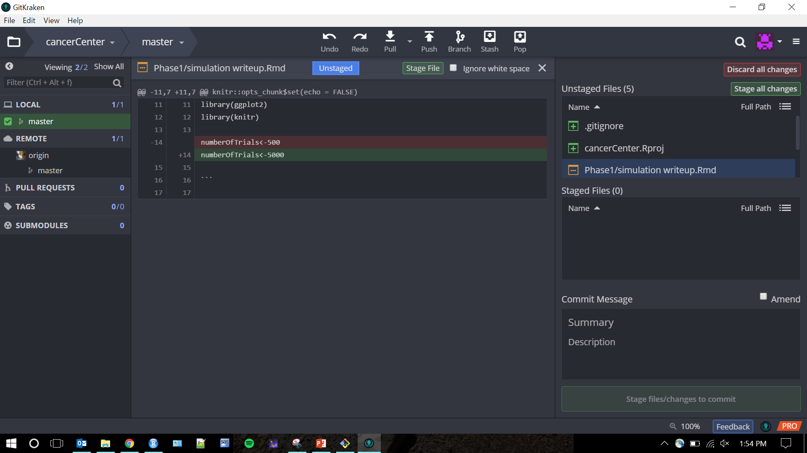
How – GitKraken

Slide 14
Before meeting
Download
Git
https://git-scm.com/
GitKraken
https://www.gitkraken.com/
Create a GitHub account
https://github.com/

